Slide 1
Lesson 5.4
Solving Equations with Two or MOre Absolute Values

Slide 2
How to Solve Equations With Multiple ABS
There are two ways to solve equations when there are multiple absolute values
First method: Algebraic Approach with Separate Cases
  For each absolute value, there will be two possibilities: “positive” or “negative”
  So if there are two ABS, we will have FOUR cases:
Solve all FOUR of these cases, get the answer, plug it back in to check if they are extraneous roots
If there are three ABS, you will then have 8 cases!
Case 1
Case 1
Case 2
Case 2
Case 3
Case 4
Case 3
Case 5
Case 6
Case 4
Case 7
Case 8

Slide 3
Since there are two absolute values, we need to consider all four cases with each
abs value being positive or negative
For cases with solutions, check them by
plugging it back in to the original equation
Case 1
Case 4
Case 2
Case 3
Case 4
No Solutions
Solution is good!
Solution is good!
No Solutions

Slide 4
Since there are two absolute values, we need to consider all four cases with each
abs being positive or negative
Check each solution by plugging it back in
Therefore, the solutions to the system
will be x = 2 and x = -1.333
Case 1
Case 2
Case 3
Case 4
Solution!
Extraneous
Extraneous
Solution!

Slide 5
Check each value of “x” by plugging it back into the equation
The solution to this equation is:
x=2.75 and x= –2.25

Slide 6
2nd Method: Graphical Approach
Treat the left side of the equation with all the ABS as a function
Find the x-intercepts from each absolute value, plug each one in separately to find the y-value of the equation [get the height of graph]
Connect these dots to get an idea of how this function will look:
y
8
4
Intersection point will also be on the RIGHT side!!
The intersection points will be on the LEFT side
x
-3
-2
-1
0
1
2
3
4
5
6
7
-2

Slide 7
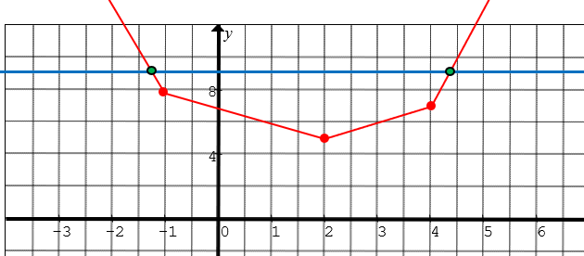
The second part of the method requires determining if the ABS in equation is either positive or negative
This depends on whether if the intersection points are either on the LEFT or RIGHT of the ABS
If the intersection is in this domain, then ALL three absolute values will be NEGATIVE, b/c it will all need to pointing the NEGATIVE side!!!

Slide 8
The second part of the method requires determining if the ABS in equation is either positive or negative
This depends on whether if the intersection points are either on the LEFT or RIGHT of the ABS
If the intersection is in this domain, the first one is positive and the other two are NEGATIVE. Use the arrows to decide if it is positive or negative!

Slide 9
The second part of the method requires determining if the ABS in equation is either positive or negative
This depends on whether if the intersection points are either on the LEFT or RIGHT of the ABS
If the intersection is in this domain, the first and second ABS are positive and the last one is NEGATIVE. Use the arrows to decide if it is positive or negative!

Slide 10
The second part of the method requires determining if the ABS in equation is either positive or negative
This depends on whether if the intersection points are either on the LEFT or RIGHT of the ABS
If the intersection is in this domain, All THREE ABS Values will be POSITIVE b/c they will point to the RIGHT!!!

Slide 11
Since the intersections are in the FAR left and Far right domains, then you will only need to solve these two equations:

Slide 12
Practice: Solve the following equations:

